Slide 1
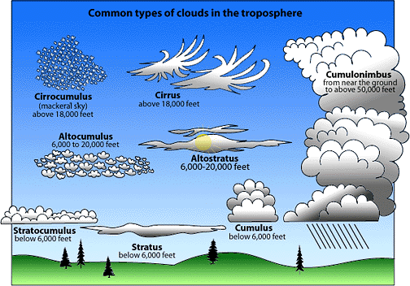
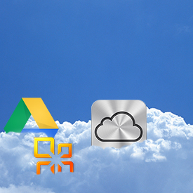
What is The Cloud?

Slide 2
The Cloud
http://safeshare.tv/w/SKimoBEpgE

Slide 3
The Mysterious Cloud
According to Griffith (2013), “…cloud computing means storing and accessing data and programs over the Internet instead of your computer’s hard drive.”

Slide 4
Frank & The Cloud
http://safeshare.tv/w/ZBamwRkhIg

Slide 5
Disadvantages of The Cloud
Servers Crash
Connection Issues
Security (The Facebook Experiment)

Slide 6
Reference
Griffith, E. (2013). What is cloud computing? PC Magazine. Retrieved July 16, 2014, from http://www.pcmag.com/article2/0,2817,2372163,00.asp

